Slide 1


ANALYZING AMAZON SALES DATA
Detailed Project Report
SAKET SHAYAN

Slide 2


PROJECT DETAIL
Project Title | Analysing Amazon Sales Data
Technology | Business intelligence
Domain name | E-Commerce
Project Difficulties Level | Advanced
Tools | Jupyter notebook, Power Bi, Ms Excel, Ms PowerPoint

Slide 3






OBJECTIVE
Finding Sales & Profit Trend month wise , year wise , yearly month wise

Slide 4









PROBLEM STATEMENT
Sales management has gained importance to meet increasing competition and the need for improved methods of distribution to reduce cost and to increase profits. Sales management today is the most important function in a commercial and business enterprise.
Do ETL : Extract-Transform-Load some Amazon dataset and find for me Sales-trend -> month wise , year wise , yearly-month wise
Find key metrics and factors and show the meaningful relationships between attributes.

Slide 5


ARCHITECTURE
Real World
Data Pre-Processing
Raw Data Collection
Importing Libraries in Jupyter Notebook
Load Dataset
Missing Value Imputations
Handling Outliers
Data Cleaning
Deployment
Insights
Power BI Desktop
Modelling
Exploratory Data Analysis (EDA)
Reporting
Low-Level Design Document
High-Level Design Document
Architecture Document
Wireframe Document
Detailed Project Report

Slide 6





DATASET INFORMATION
This is a Sales related dataset that contains Information like Sales Amt., Cost Amt., Sales Prices, List Prices, Sales Margins, Sales Quantities, etc.

Slide 7

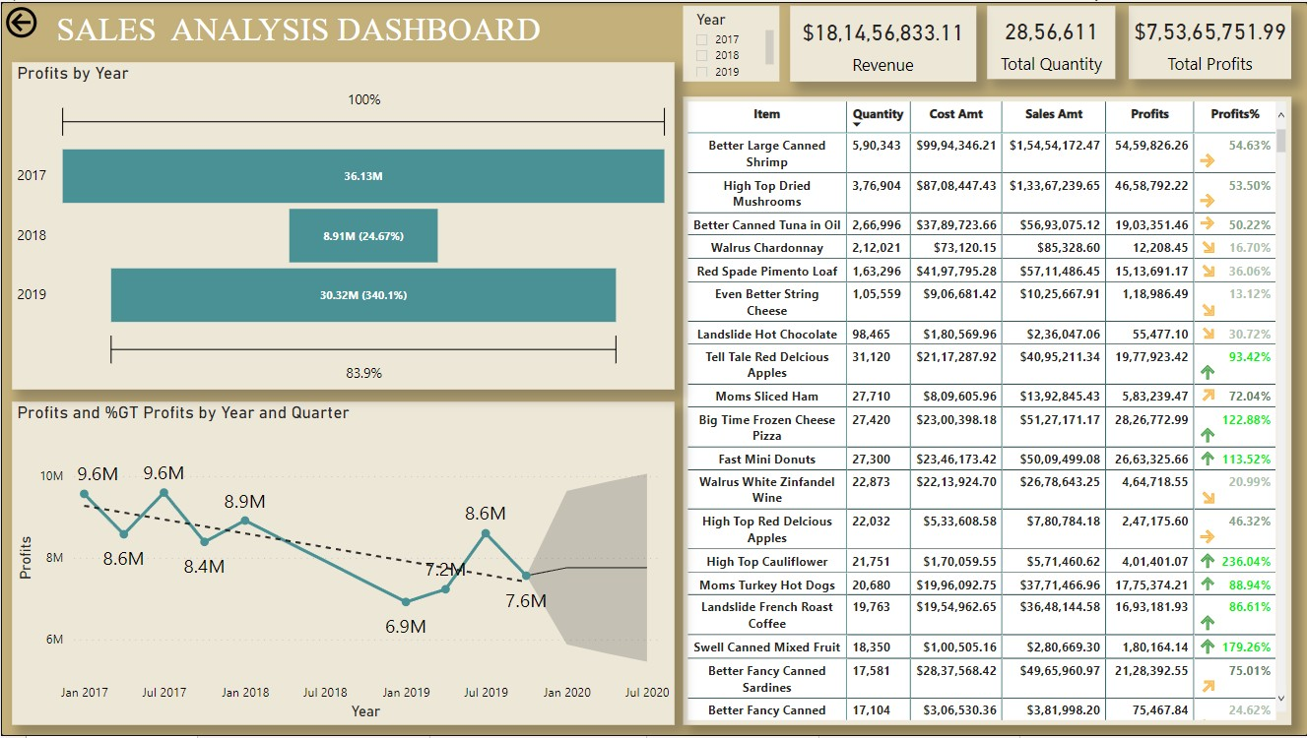
At $15,454,172.47, Better Large Canned Shrimp had the highest Sales and was 7,549,200.21% higher than Kiwi Lox, which had the lowest Sales at
$204.71. Better Large Canned Shrimp accounted for 8.51% of Sales. Profits trended down, resulting in a 16.16% decrease between 2017 and 2019. It trended down, resulting in a 21.15% decrease and dropped from $9,598,696.65 to $7,568,565.85 during its steepest decline between January 2017 and October 2019.

Slide 8

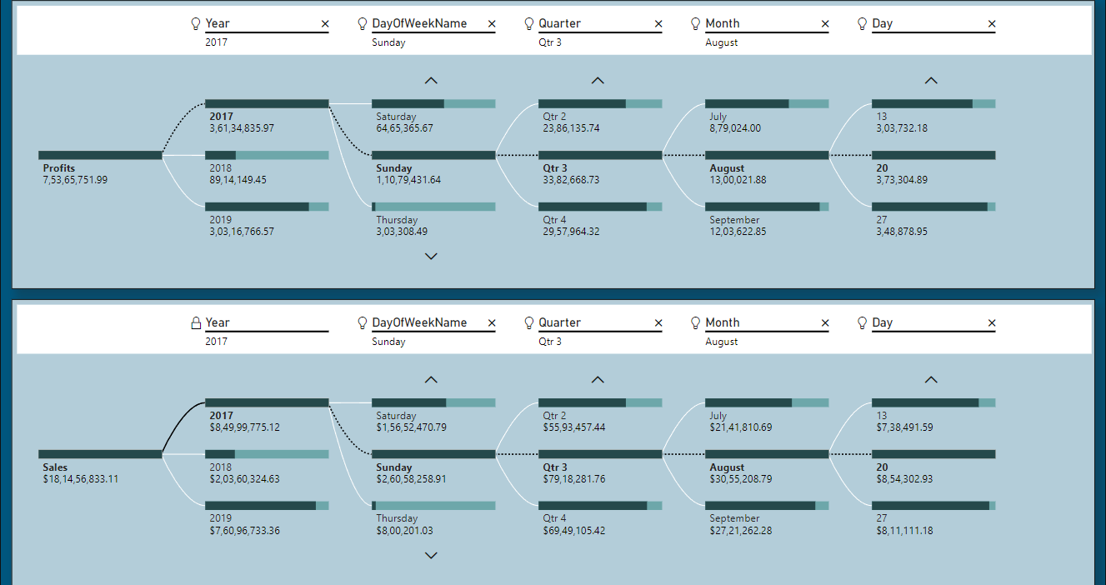
In this Decomposition Tree visual, we can Analyse how much Sales & Profits were made from 2017 to 2019.
Comparing 3 Years, 2017 was the year in which highest Sales & Profits were made, which was $8,49,99,775.12, $3,61,34,835.97 and it was most made on Sunday, which was $2,60,58,258.91, $1,10,79,431.64. Sales & Profits were very balanced in all 4 Quarters but it was highest in Q3($79,18,281.76, $33,82,668.73). August was the month in which highest Sales & Profits were recorded, which was $30,55,208.79, $13,00,021.88. In that Month Sales & Profits were generated on the 6th, 13th,20th, 27th

Slide 9

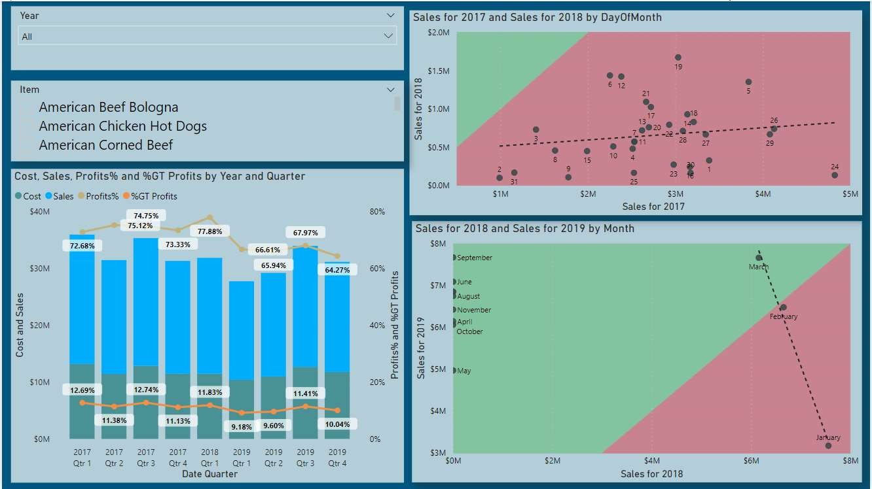
In 2017 Revenue was $8,49,99,775.12 and Profit was $3,61,34,835.97 which was 72.68% of Cost Amt. and it was 47.95% of Grand Total Profit. In 2018 Revenue was $20,360,324.63 and Profit was $8,914,149.95 which was 77.88% of Cost Amt. and it was 11.82% of Grand Total Profit. In 2019 Revenue was $76,115,603.9 and Profit was $30,322,184.85 which was 66.22% of Cost Amt. and it was 40.21% of Grand Total Profit.
If we Compare Sales for 2017 and Sales for 2018 we found that on 24, 26 and 29 there was largest decline among Days. The relative contributions made by 24, 19, 6 changed the most.
If we Compare Sales for 2018 and Sales for 2019 we found that on September, June and December there was largest increase among the months. The relative contributions made by Jan, Feb, Mar changed the most.

Slide 10
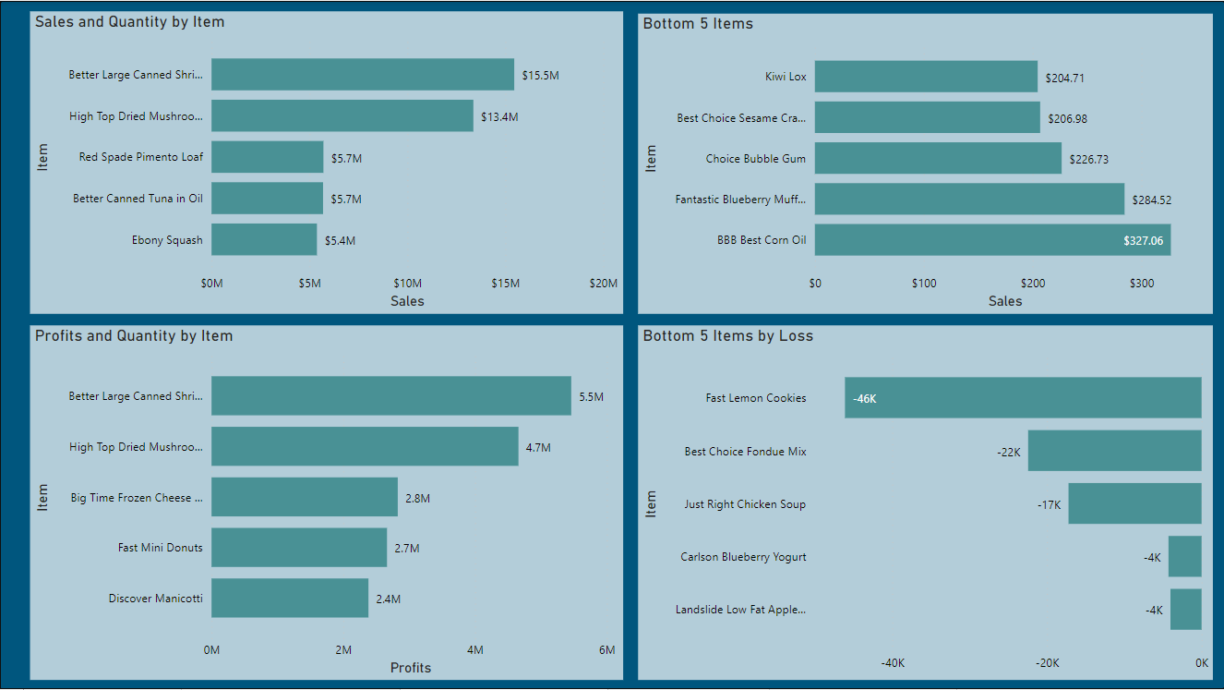
-At $15,454,172.47, Better Large Canned Shrimp had the highest Sales and was 187.21% higher than Ebony Squash, which had the 5th Highest Sales at
$5,380,727.75. Better Large Canned Shrimp accounted for 33.89% of Sales. Across all 5 Item, Sales ranged from $5,380,727.75 to $15,454,172.47.
-At $5,459,826.26, Better Large Canned Shrimp had the highest Profits and was 129.24% higher than Discover Manicotti, which had the 5th highest Profits
at $2,381,667.84. Better Large Canned Shrimp accounted for 30.35% of Profits. Across all 5 Item, Profits ranged from $2,381,667.84 to $5,459,826.26.
-At $327.06, BBB Best Corn Oil had the 5th lowest Sales and was 59.77% higher than Kiwi Lox, which had the lowest Sales at $204.71. BBB Best Corn Oil accounted for 26.16% of Sales. Across all 5 Item, Sales ranged from $204.71 to $327.06.
-At $4,026.61, Landslide Low Fat Apple Butter had the 5th Highest Loss and was 91.27% higher than Fast Lemon Cookies, which had the Highest Loss at
$46,106.59.Fast Lemon Cookies accounted for 49.03% of Loss.Across all 5 Item, Loss ranged from ($46,106.59) to ($4,026.61).

Slide 11
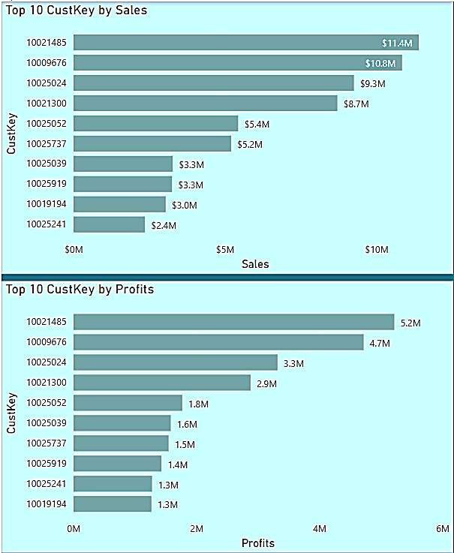
At $1,13,97,206.36, 10021485 had generated highest
Sales and was 383.63% higher than
10025241, which had the 5th highest Sales at
$23,56,595.66. 10021485 accounted for 18.16% of
Sales. Across all 10 CustKey, Sales ranged from
$23,56,595.66 to $1,13,97,206.36.
At $52,15,559.07, 10021485 had generated highest Profits and was 312.11% higher than 10019194, which had the 5th highest Profits at $12,65,561.04. Across all 10 CustKey, Profits ranged from $1265561.04 to
$5215559.07.

Slide 12

Sales & Profit:
Sales trended down, resulting in a 10.42% decrease between January 2017 and January 2018. Sales started trending down in January 2017, falling by 10.42% ($23,69,531.66) in 4 quarters. Sales dropped from $2,27,29,856.29 to $2,03,60,324.63 during its steepest decline between January 2017 and January 2018. Sales trended down, resulting in a 5.06% decrease between January 2018 and October 2019. Sales started trending up on April 2019, rising by 6.22% ($11,31,718.23) in 2 quarters. Sales jumped from $1,81,99,115.14 to $1,93,30,833.37 during its steepest incline between April 2019 and October 2019.
Profits trended down, resulting in a 6.82% decrease between January 2017 and January 2018. Profits started trending down in January 2017, falling by 6.82% ($6,52,731.37) in 4 quarters. Profits dropped from $95,66,880.82 to $89,14,149.45 during their steepest decline between January 2017 and January 2018. Profits trended down, resulting in a 15.16% decrease between January 2018 and October 2019.
At $87,73,249.43, Better Large Canned Shrimp had the highest Sales and was 42,85,596.56% higher than Kiwi Lox, which had the lowest Sales at
$204.71. Sales and total Profits are negatively correlated with each other. Better Large Canned Shrimp accounted for 9.10% of Sales. Sales and Profits diverged the most when the Item was Better Large Canned Shrimp when Sales were $57,32,729.64 higher than Profits.

Slide 13
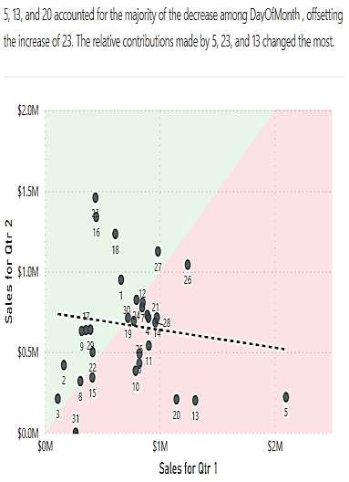
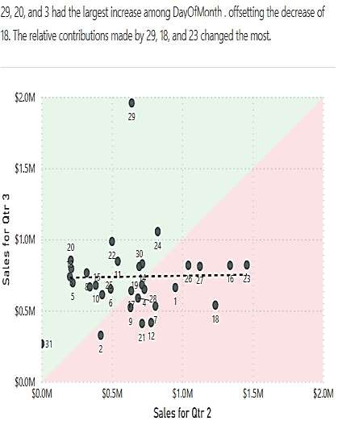
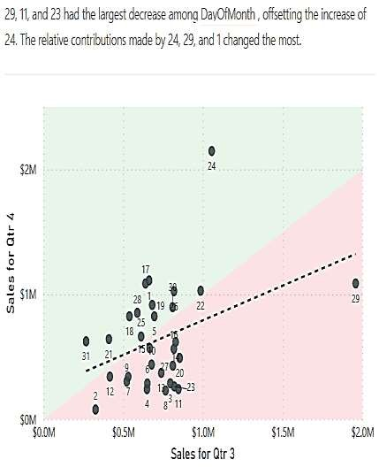
2017
At $66,80,923.04, Better Large Canned Shrimp had the highest Sales and was 157.27% higher than Better Canned Tuna in Oil, which had the 5th highest Sales at
$25,96,886.19. Better Large Canned Shrimp accounted for 32.11% of Sales. Across all 5 Item, Sales ranged from $25,96,886.19 to $66,80,923.04.
At 24,19,306.47, Better Large Canned Shrimp had the highest Profits and was 121.20% higher than Ebony Squash, which had the 5th lowest Profit at 10,93,739.23. Across
all 5 Items, Profits ranged from 10,93,739.23 to 24,19,306.47.
At $230.81, Choice Mints had the 5th lowest Sales and was 11.51% higher than Best Choice Sesame Crackers, which had the lowest Sales at $206.98. Choice Mints accounted for 20.62% of Sales. Across all 5 Items, Sales ranged from $206.98 to $230.81.
At -1,507.97, Landslide Low Fat Apple Butter had the 5th lowest Profits and was 92.67% higher than Fast Lemon Cookies, which had the lowest Profits at -20,585.56. Across
all 5 Items, Profits ranged from -20,585.56 to -1,507.97.

Slide 14
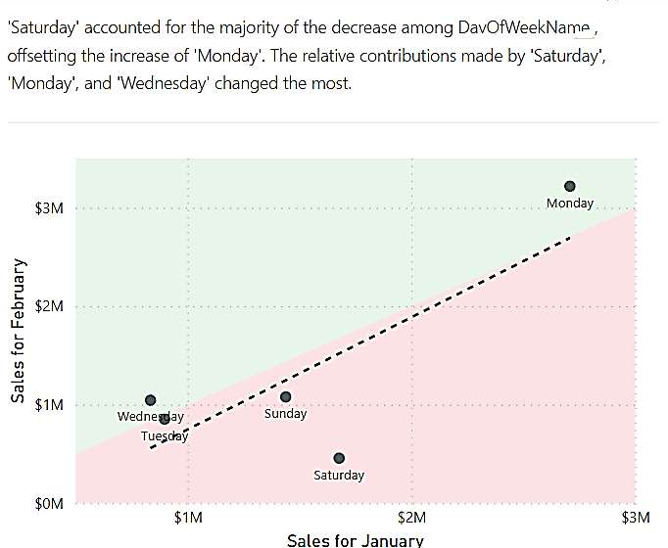
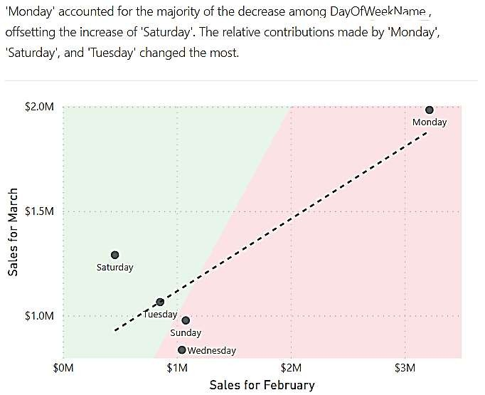
2018
At $23,61,289.63, Better Large Canned Shrimp had the highest Sales and was 11,78,423.47% higher than Best Choice Low Fat Popcorn, which had the lowest Sales at $200.36. Better Large Canned Shrimp accounted for 11.60% of Sales. Sales and Profits diverged the most when the Item was Better Large Canned Shrimp when Sales were $14,71,795.33 higher than Profits. Better Large Canned Shrimp had the highest Sales and was 247.42% higher than Discover Manicotti, which had the 5th Highest Sales at $6,79,668.01. Better Large Canned Shrimp accounted for 38.04% of Sales. Across all 5 Item, Sales ranged from
$6,79,668.01 to $23,61,289.63.
At 8,89,494.30, Better Large Canned Shrimp had the highest Profits and was 169.82% higher than Tell Tale Red Delicious Apples, which had the lowest Profits at 3,29,663.79. Across all 5 Item, Profits ranged from 3,29,663.79 to 8,89,494.30. At 86,608, Better Large Canned Shrimp had the highest Quantity sold and was 8,931.07% higher than Discover Manicotti, which had the 5th highest Quantity sold at 959. Better Large Canned Shrimp accounted for 61.60% of Quantity. Across all 5 Items, Quantity ranged from 959 to 86,608.
Blue Label Fancy Canned Clams and Cutting Edge Sliced Turkey tied for 5th lowest Sales at $208.82, followed by Bravo Canned Tuna in Water. Best Choice Low
Fat Popcorn had the lowest Sales at $200.36. Across all 5 Items, Sales ranged from $200.36 to $208.82.
At -548.87, Blue Label Rice Soup had the 5th lowest Profits and was 82.21% higher than Fast Lemon Cookies, which had the lowest Profits at -3,085.25. Across all 5 Items, Profits ranged from -3,085.25 to -548.87.

Slide 15
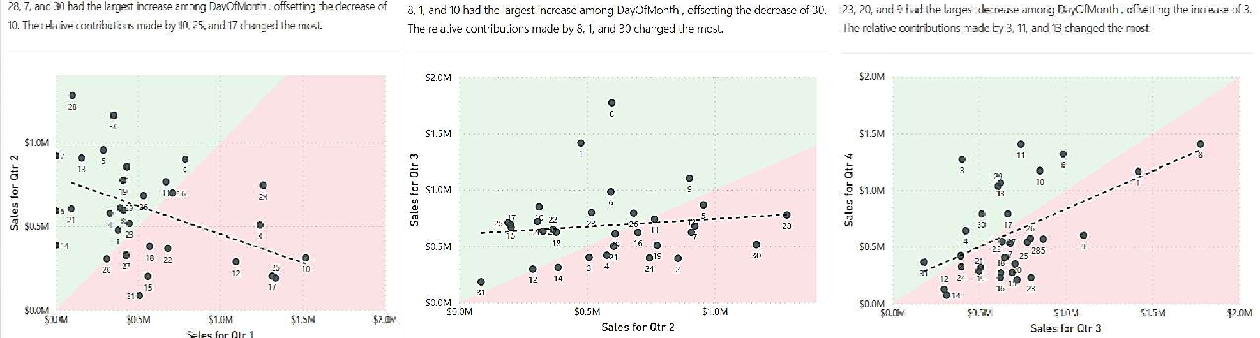
2019
At $64,11,959.80, Better Large Canned Shrimp had the highest Sales and was 31,16,132.41% higher than Special Oatmeal, which had the lowest Sales at $205.76. Better Large Canned Shrimp accounted for 8.43% of Sales, Better Large Canned Shrimp had the highest Sales and was 182.90% higher than Ebony Squash, which had the 5th lowest Sales at $22,66,482.62. Better Large Canned Shrimp accounted for 33.56% of Sales. At 21,51,025.49, Better Large Canned Shrimp had the highest Profits and was 123.87% higher than Discover Manicotti, which had the 5th highest Profits at 9,60,848.73. Across all 5 Item, Profits ranged from 9,60,848.73 to 21,51,025.49.
Across all 5 Item, Sales ranged from $22,66,482.62 to $64,11,959.80.
At $240.05, Choice White Chocolate Bar had the 5th lowest Sales and was 16.67% higher than Special Oatmeal, which had the lowest Sales at $205.76. Choice White Chocolate Bar accounted for 21.65% of Sales.Across all 5 Items, Sales ranged from $205.76 to $240.05. At -2,150.52, Good Chablis Wine had the 5th lowest Profits and was 90.41% higher than Fast Lemon Cookies, which had the lowest Profits at -22,435.78. Across all 5 Items, Profits ranged from -22,435.78 to -2,150.52.

Slide 16
THANK YOU

